Slide 1

PathFinder
PathFinder
Christopher Costelloe K00233369, Kevin Dunne K00232599, Jekaterina Pavlenko K00224431
Chris Costelloe K00233369, Kevin Dunne K00232599, Jekaterina Pavlenko K00224431

Slide 2

Background
Why we chose this project?
What is learning outcomes?
What is unique about it?

Slide 3
Prototype – Web Application

Slide 4
Prototype – Android Mobile Application

Slide 5
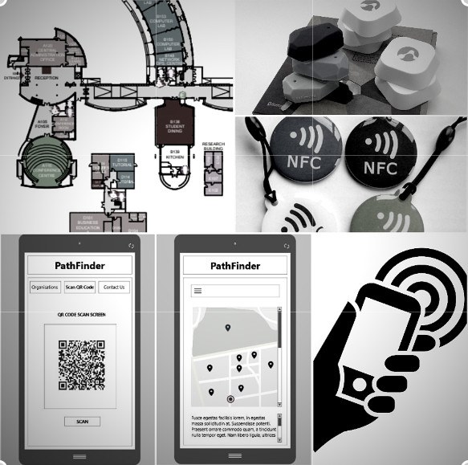
Technologies
List of what we are going to use:
Bluetooth beacons
NFC tags
QR codes
Barcodes

Slide 6
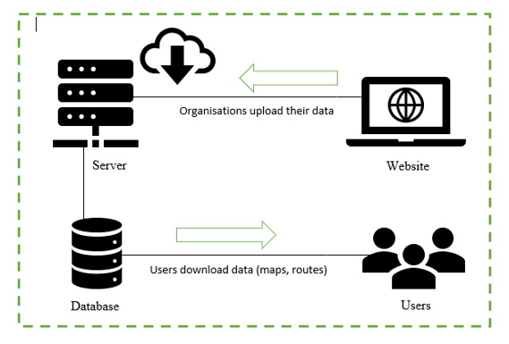
Architecture diagram

Slide 7
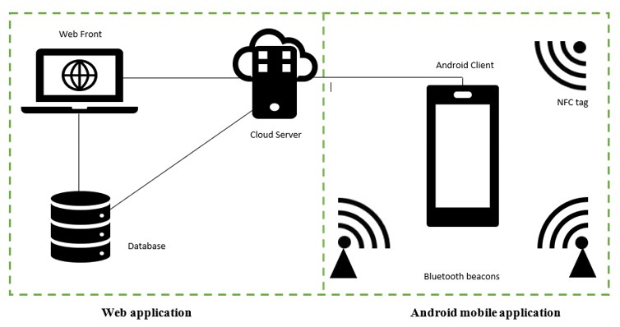
Architecture diagram

Slide 8
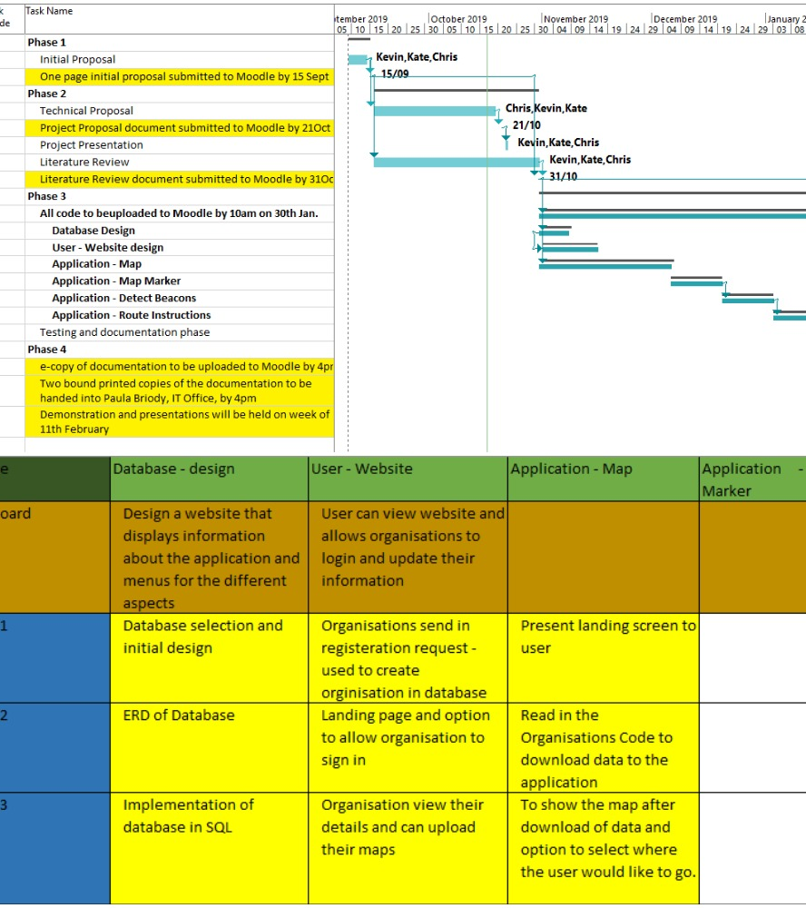
Project Management
Gantt chart & Backlog

Slide 9
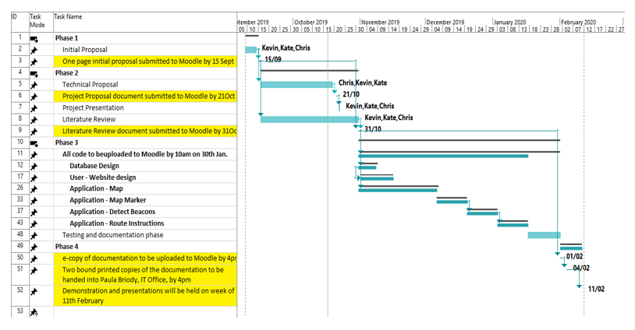
Gantt chart

Slide 10
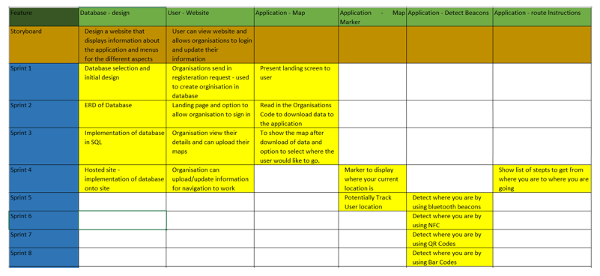
Sprints

Slide 11

Collaboration Tools:
List of what we are using:
GitHub
Google Drive
Messenger
Microsoft Office – Word, Excel etc.

Slide 12
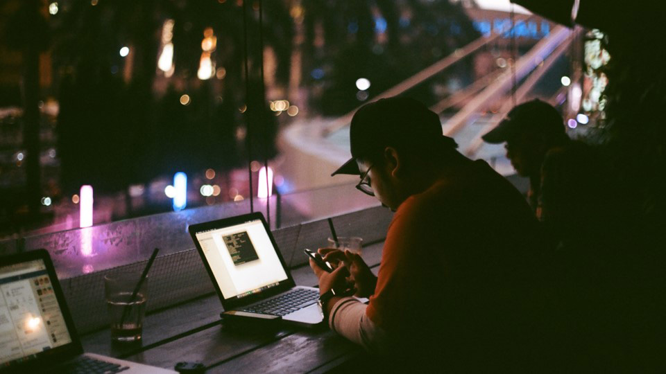
Team Management
Meetings – Chairman, Scribe etc.
GitHub - updates
Problems & solutions

Slide 13

THANK YOU

